Slide 1
Customer Purchase Behavior in Retail using Data Analytics
By
Arivazhagan
MBT7

Slide 2


Slide 3

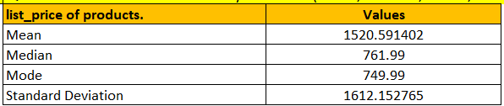
Q1: Calculate the summary statistics (mean, median, mode, standard deviation) for the list_price of products.
Mean: The average value of a set of numbers.
Function: “= AVERAGE(range)”
Median: The middle value in a set of numbers when arranged in order
Function: “MEDIAN(range)”
Mode: The average value of a set of numbers.
Function: = “MODE.SNGL(range) for a single mode or =MODE.MULT(range) for multiple modes.”
Standard Deviation: A measure of the amount of variation or dispersion in a set of numbers.
Function: = “STDEV.P(range) for population standard deviation or =STDEV.S(range) for sample standard deviation.”

Slide 4
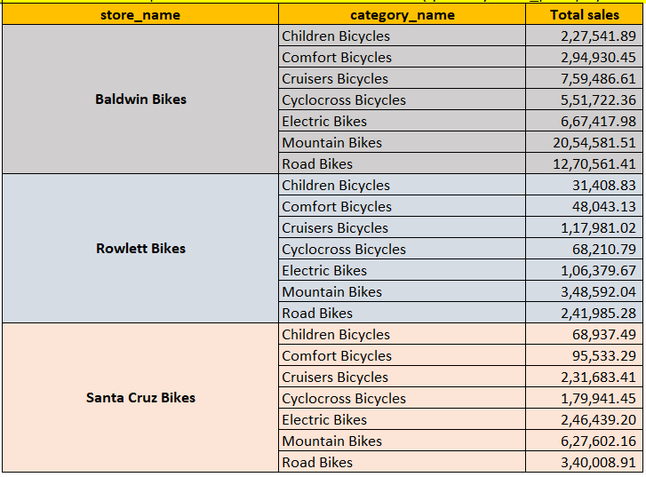
Q2: Create a pivot table to summarize total sales (quantity * list_price) by store and by product category.
A pivot table is a powerful data summarization tool in Excel.
It enables automatic sorting, counting, totaling, or averaging of data from one table, displaying the results in a new, organized table.
In this example, we created a pivot table to summarize total sales by store and product category, offering a clear view of sales performance across different stores and categories.

Slide 5
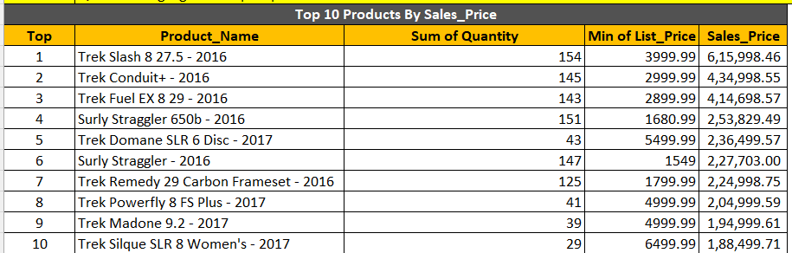
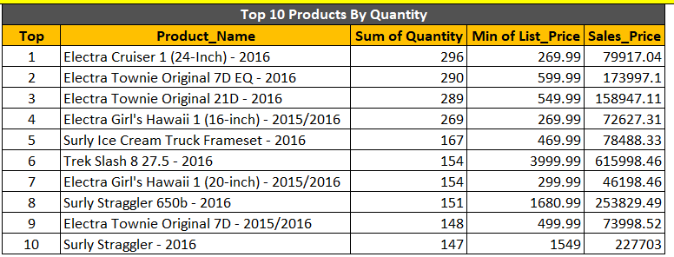
Q3: Highlight the top 10 products based on total sales.
I have created the top 10 products using two different criteria:
by Sales Price.
by Quantity.
By Sales Price:
This helps to identify the top-selling products in terms of revenue.
By Quantity
This helps in managing the inventory by showing which products have the highest number of units sold.

Slide 6
Q4: Question: Identify and correct any inconsistencies or missing data in the customers table.
The Customer Table Has Been Cleaned and Uploaded
Here are important points to check:
Missing Data:
Identify and address any blank cells in crucial columns.
Data Consistency:
Ensure uniform formats for entries and correct any typographical errors.
Duplicate Entries:
Locate and remove or consolidate duplicate records.
Formatting:
Standardize text case, address formats, and other data formats for uniformity.
Outliers and Inconsistencies:
Identify and rectify values that significantly deviate from the norm or are logically inconsistent.

Slide 7
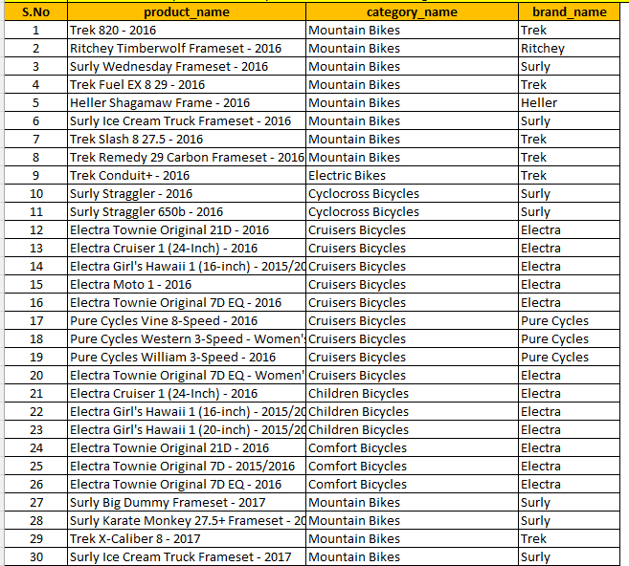
Q5: Question: Use VLOOKUP to match product names with their respective categories and brands.
I have used a pivot table and combined both category_name and brand_name. Instead of using VLOOKUP.
I created a reference between the tables and used a pivot table for easier processing.
I have connected all 307 Product and shared the first 30 products in the image.

Slide 8
Q6: Question: Ensure that all email addresses in the staffs table are unique and correctly formatted.
The Customer Sheet has been updated, and no duplicates were found.
I used data validation to check and cleaned the data for seamless processing.

Slide 9
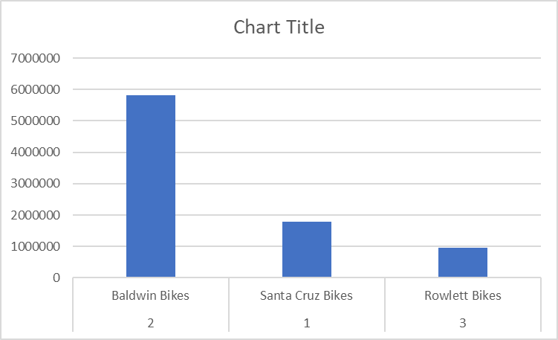
Q7: Create a bar chart to visualize the total sales by store.
I used a pivot table and chart to create this visualization. In this chart,
we can see that Baldwin Bikes (Store_ID - 2) is performing better in sales compared to the other two stores.

Slide 10

Q8: Perform a what-if analysis to see how changes in discount
Here, you can change the product name.
The price will automatically adjust according to the selected product.
You can also enter a discount percentage
The selling price will update based on your selection and the discount you have entered.

Slide 11


Slide 12
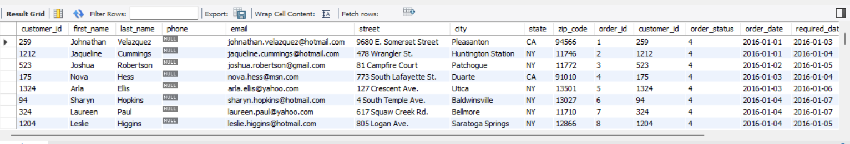
Q1. Retrieve all details of customers who have placed orders
Select *
From customers
Join orders
On customers.customer_id = orders.customer_id;
Overview
Selects all columns from the joined tables.
Joins customers and orders tables on the matching customer_id.(inner Join)
Retrieves details of customers who have placed orders.

Slide 13
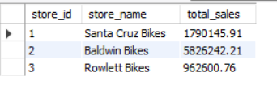
Q2. Calculate the total sales for each store.
Select s.store_id, s.store_name,
Round(Sum(oi.list_price * oi.quantity),2) AS total_sales
From orders oJoin order_items oi On o.order_id = oi.order_id
Join stores s
On o.store_id = s.store_id
Group by s.store_id, s.store_name;
Overview
Selects store ID and store name along with total sales.
Calculates total sales using SUM of list_price * quantity for each store.
Rounds total sales to 2 decimal places.
Joins orders, order_items, and stores tables based on relevant IDs.
Groups results by store ID and store name to aggregate the sales data per store.

Slide 14
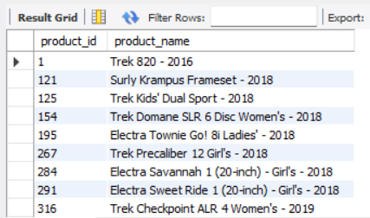
Q3. Find the products that have never been ordered.
Select product_id, product_name
From products
Where product_id
Not in (Select product_id From order_items);
Overview
Selects product ID and product name from the products table.
Filters products where the product ID is not found in the list of product IDs from the order_items table.
Identifies products that have never been ordered.

Slide 15
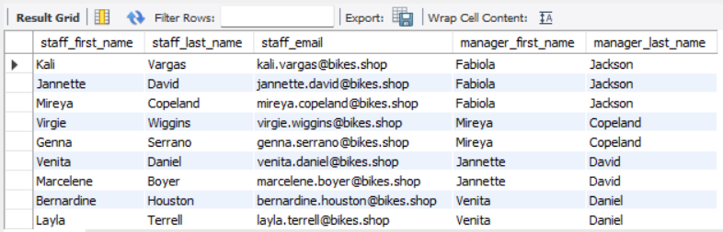
Q4. Retrieve the names and email addresses of staff along with the names of their managers.
Select
st.first_name AS staff_first_name,
st.last_name AS staff_last_name,
st.email AS staff_email,
ma.first_name AS manager_first_name,
ma.last_name AS manager_last_name
From staffs st
Join staffs ma ON st.manager_id = ma.staff_id;
Overview
Selects first name, last name, and email of staff members.
Selects first name and last name of their managers.
Joins the staffs table with itself using the manager_id to staff_id relationship. (Self Join)
Retrieves staff details along with their respective managers' details.

Slide 16
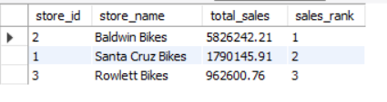
Q5. Rank stores based on their total sales.
Select s.store_id, s.store_name,
ROUND(SUM(oi.list_price * oi.quantity), 2) AS total_sales,
Rank() Over (Order By Sum(oi.list_price * oi.quantity) Desc) as sales_rank
From orders o
Join order_items oi
on o.order_id = oi.order_id
Join stores s on o.store_id = s.store_id
Group by s.store_id, s.store_nameOrder by sales_rank;
Overview
Selects store ID and store name along with total sales.
Calculates total sales by summing list_price * quantity for each store, rounded to 2 decimal places.
Ranks stores based on total sales in descending order.
Joins orders, order_items, and stores tables using relevant IDs.
Groups results by store ID and store name to aggregate sales data per store.
Orders the results by sales rank to list stores by their sales performance.

Slide 17
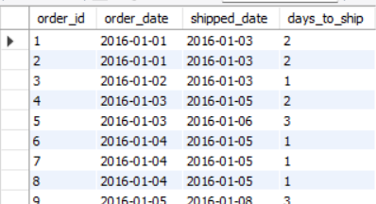
Q6. Calculate the number of days each order took to ship.
Select order_id, order_date,shipped_date,
datediff(shipped_date, order_date) AS days_to_ship
From orders;
Overview
Selects order ID, order date, and shipped date from the orders table.
Calculates the difference in days between the shipped date and the order date.
Aliases the difference as "days_to_ship" to show the number of days taken to ship each order.

Slide 18
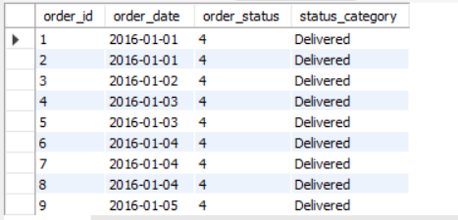
Q7. Categorize orders based on their status.
Selects order ID, order date, and order status from the orders table.
Uses a CASE statement to categorize the order status:
'Recived' for order_status = 1
'Processing' for order_status = 2
'Shipped' for order_status = 3
'Delivered' for order_status = 4
'Cancelled' for order_status = 5
'Other' for any other status
Aliases the result as "status_category" to provide a readable description of the order status.
Select
order_id,
order_date,
order_status,
Case
When order_status = 1 Then 'Recived’
Whem order_status = 2 Then 'Processing'
When order_status = 3 Then 'Shipped'
When order_status = 4 Then 'Delivered’
When order_status = 5 Then 'Cancelled’
Else 'Other'
End as status_category
From orders;

Slide 19
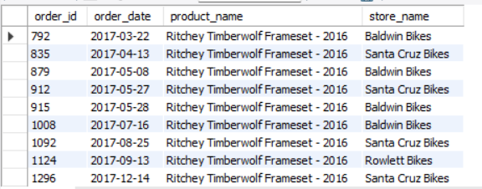
Q8. Retrieve all orders along with the product names and the store names.
Select
o.order_id,
o.order_date,
p.product_name,
s.store_name
From orders o
Join order_items oi on o.order_id = oi.order_id
Join products p ON oi.product_id = p.product_id
Join stores s
On o.store_id = s.store_id;
Selects order ID, order date, product name, and store name.
Joins the orders table (o) with the order_items table (oi) on order_id.
Joins the order_items table (oi) with the products table (p) on product_id.
Joins the orders table (o) with the stores table (s) on store_id.
Retrieves details about orders including product names and the stores where the orders were placed.

Slide 20
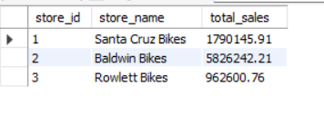
Q9. Create a temporary table to store intermediate sales calculations.
Create View view_store_sales as
Select s.store_id,
s.store_name,
Round(SUM(oi.list_price * oi.quantity),2) as total_sales
From orders o
Join order_items oi
on o.order_id = oi.order_id
Join stores s
on o.store_id = s.store_id
Group By s.store_id, s.store_name;
Creates a view named view_store_sales.
Selects store ID and store name from the stores table.
Calculates total sales by summing list_price * quantity for each store, rounded to 2 decimal places.
Joins orders, order_items, and stores tables using relevant IDs.
Groups results by store ID and store name to aggregate sales data per store.
Stores the result in a view for easy access to total sales per store.

Slide 21


Slide 22
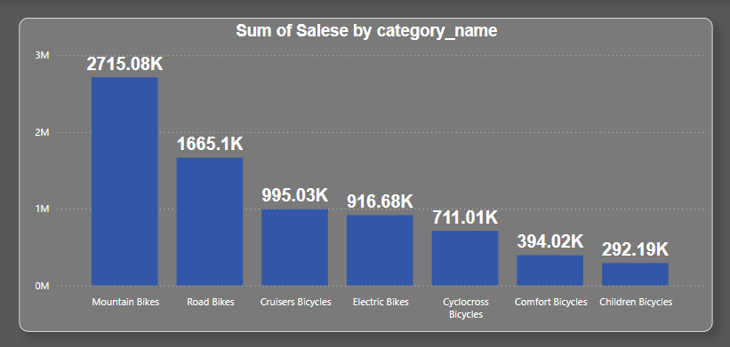
Q-1 Create a bar chart to show total sales by product category
Here we can see the Mountain Bikes category has the highest sales compared to other bike categories, significantly contributing to the overall sales.
Mountain Bikes: 2,715.08K. - 35.31% - Highest contribution to overall sales.
Road Bikes: 1,665.1K. - 21.66% - Second highest contribution.

Slide 23
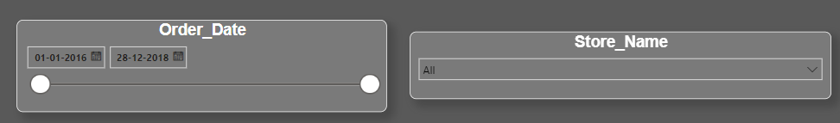
Q-2 Add slicers to filter sales data by store and date range.
Added 2 slicers for store sales and order date

Slide 24
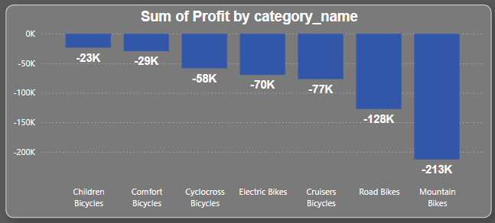
Q-3 Create a calculated column to show the profit margin for each order item.
The profit chart indicates a net loss across all categories.
We believe this is due to the discounts we offer.

Slide 25
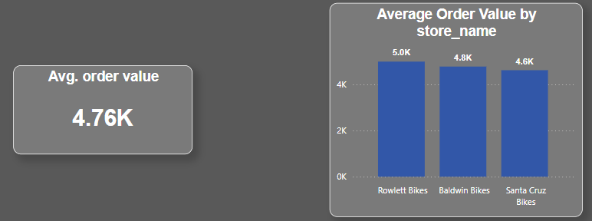
Q-4 Create a measure to calculate the average order value.
The overall average order value is 4.76K.
When we look at the stores individually,
Rowlett Bikes has the highest overall order value of 5.0K.

Slide 26
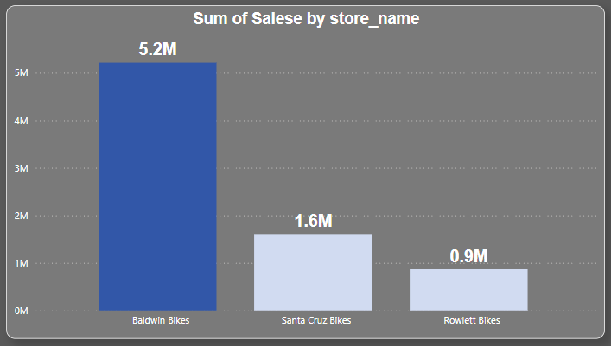
Q-5 Apply conditional formatting to highlight
top-performing stores.
Baldwin Bikes has the highest sales at 5.2M, so it is highlighted.
The other two stores are in lighter colors to help the audience easily see the important point.

Slide 27
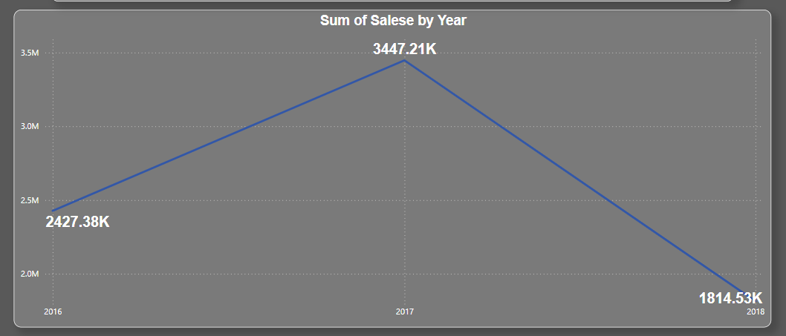
Q-6 Create a hierarchy for drill-down analysis of sales data by year, month, and day
We have created a drill-through hierarchy for date by sales.
we can drill down from year to month and day.
This feature helps to see sales changes over the year, month, and day, making it easier to identify trends

Slide 28
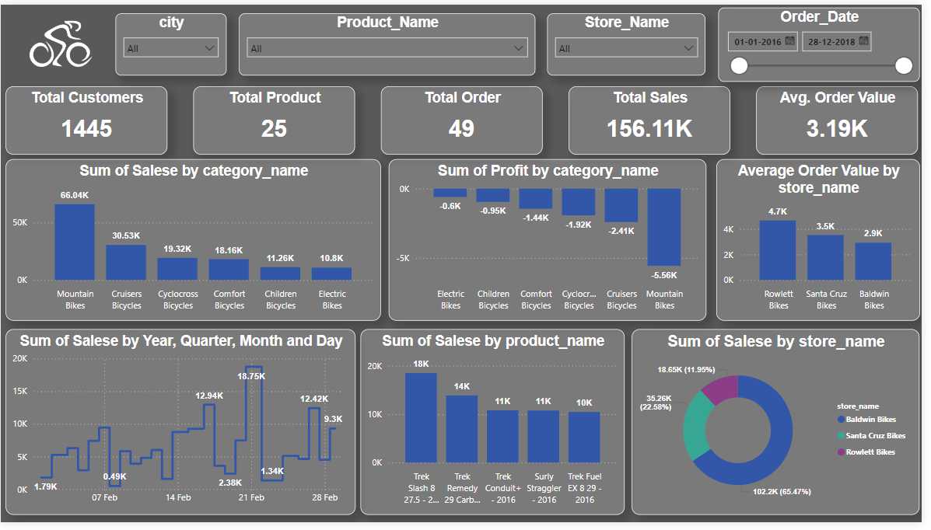
Q-7 Create an interactive dashboard to display key sales metrics.
Combined all charts created throughout the project.
Added a few additional charts.
Provides a basic overview of the data.

Slide 29
Q-8 Clean and transform data from multiple tables before loading into the Power BI model.
All tables have been cleaned and transformed before being uploaded into the Power BI model

Slide 30
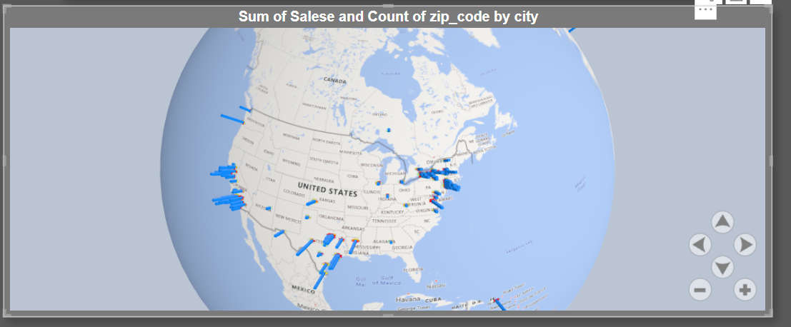
Q-9 Utilize custom visuals to display geographic sales data.
I have used an Custom visual called Glob Map.

Slide 31
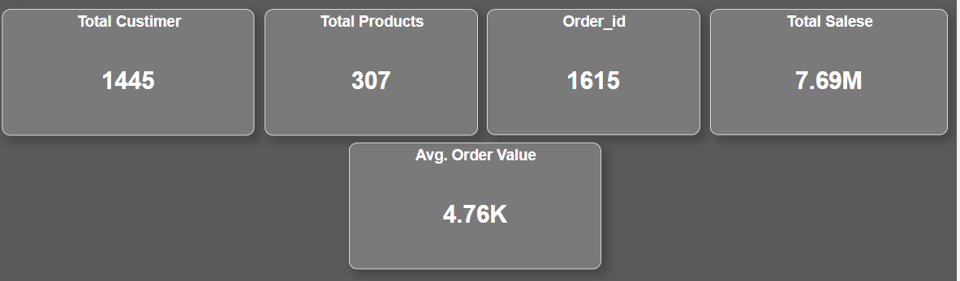
Q-10 Create KPIs to track sales targets versus actual sales.
5 Important KPIs
Total Customers: 1445
Total Products: 307
Order IDs: 1615
Total Sales: 7.69M
Average Order Value: 4.76K

Slide 32
Q-10 Create KPIs to track sales targets versus actual sales.
5 Important KPIs
Total Customers: 1445
Total Products: 307
Order IDs: 1615
Total Sales: 7.69M
Average Order Value: 4.76K

Slide 33
Excel to Power BI.

Slide 34
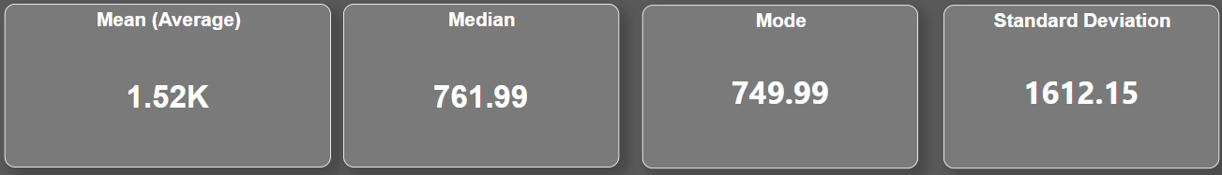
Ep-1 Import the summary statistics table for list_price calculated in Excel into Power BI.
The following are the statistics summary.
Mean is 1.52K
The median is761.99
Mode is 749.99
Standard Deviation is 1612.15

Slide 35
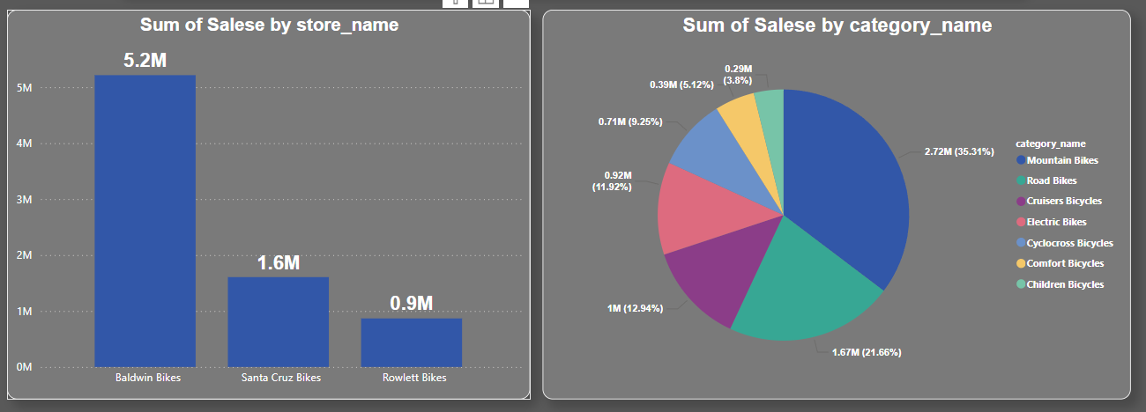
Ep-2 Import the pivot table summarizing total sales by store and by product category into Power BI.
The bar chart show the top performing Store by sale.
The pie chart show the sales by category.

Slide 36
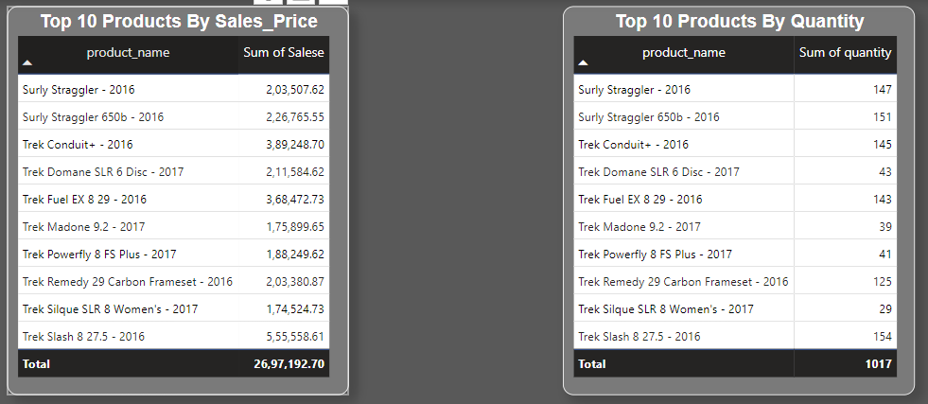
Ep-3 Import the highlighted top 10 products based on total sales from Excel into Power BI.
I have separated the top 10 products by sales and quantity sold for a better understanding of sales and inventory.

Slide 37
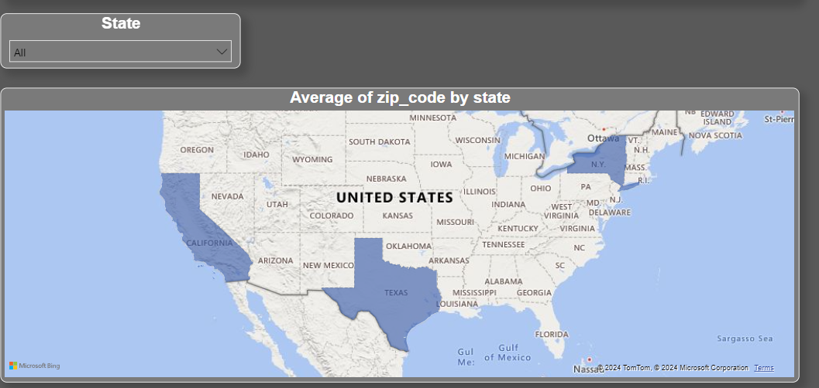
Ep-4 Import the cleaned customers data from Excel into Power BI.
The map shows the top performing staes.

Slide 38
SQL to Power BI.

Slide 39
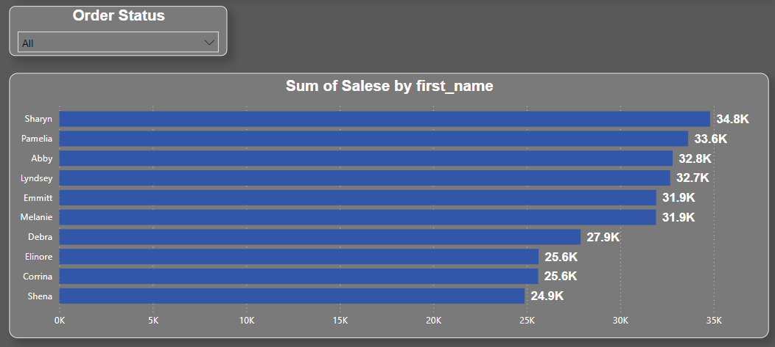
SQL-P1 Import the cleaned customers data from Excel into Power BI.
This chart shows the top 10 customers by sales, and we can filter them by order status to get a better understanding of where the orders are and their current status.

Slide 40
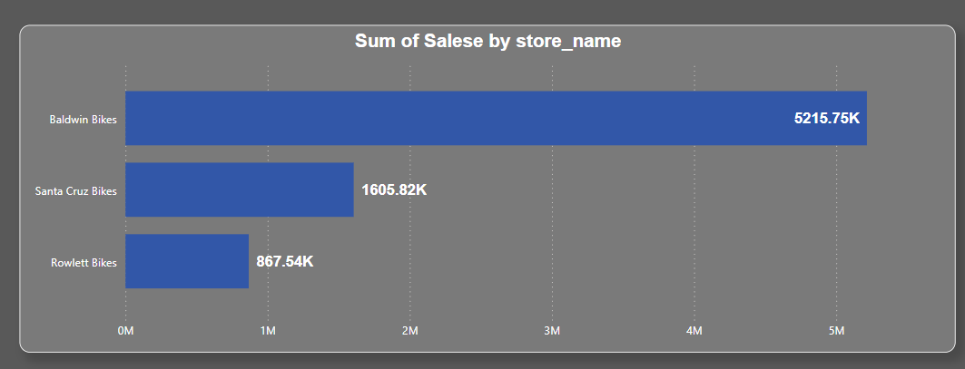
SQL-P2 Import the cleaned customers data from Excel into Power BI.
This chart shows the top 10 customers by sales, and we can filter them by order status to get a better understanding of where the orders are and their current status.

Slide 41
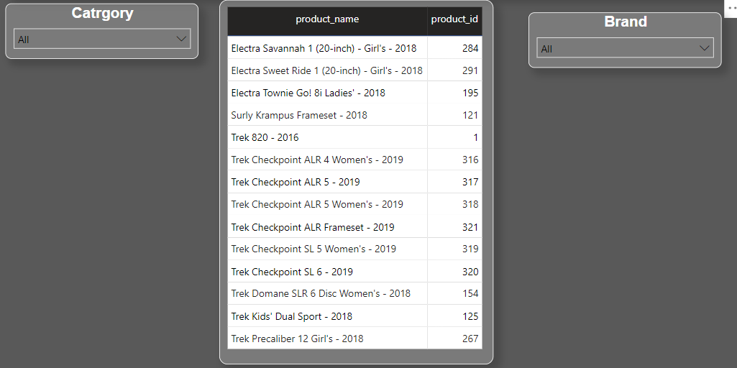
SQL-P3 Import the result of the query finding products that have never been ordered into Power BI.
These are the product that have neve been sold
You can use the slicers to find the products by category and brands.

Slide 42
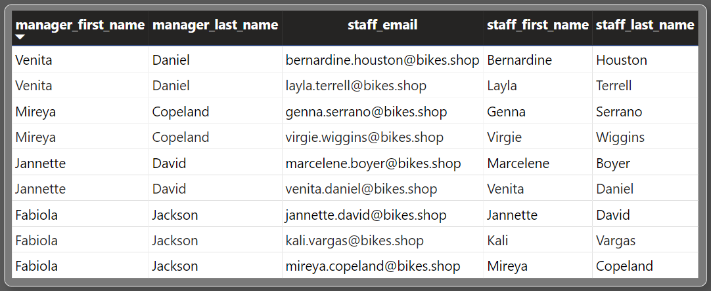
SQL-P4 Import the result of the query retrieving staff names and their manager names into Power BI.
This chart explains the staffs and their manager.

Slide 43
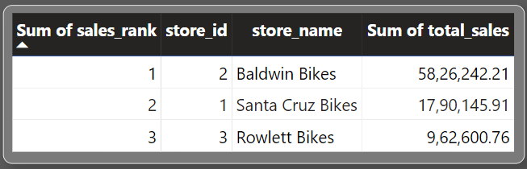
SQL-P5 Import the result of the query ranking stores based on total sales into Power BI.
In this table chart we can see store _id 2 is performing well compared to other stores.

Slide 44
Thank you
By
Arivazhagan
MBT7

